Slide 1
Employee Attrition Analysis
August 2019 Grace Lang - DDS Analytics

Slide 2
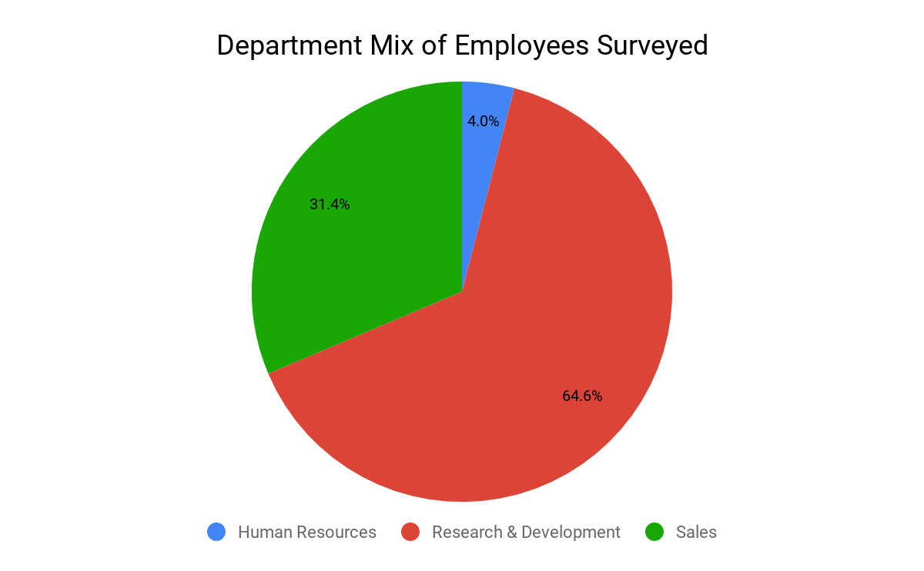
Background
Purpose Build a model that helps predict attrition for employees, reveal top 3 factors that lead to attrition, while understanding some common trends of employees who decide to leave the company.
Data Highlights
Current employee attrition is around 16%
870 employees included in dataset
Notes:
Attrition can be costly to the company, what are some ways to predict attrition and incorporate new practices into the culture in order to
https://www.zenefits.com/blog/your-company-healthy-employee-retention-rate/

Slide 3
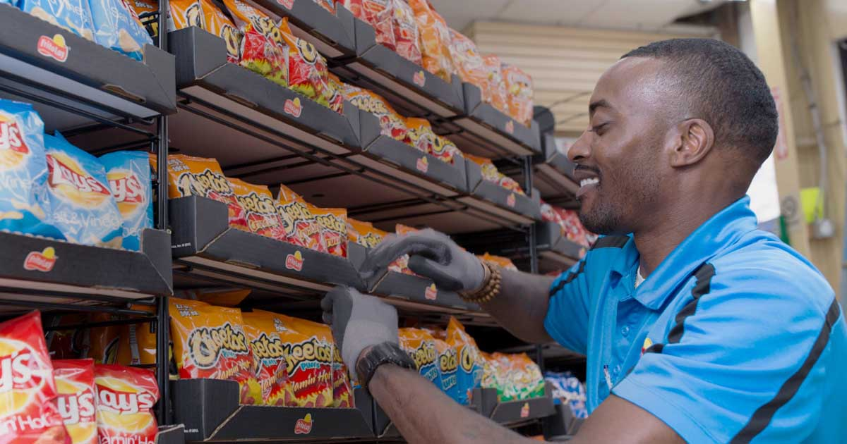
Methodology
Data Cleaning
Removed static variables
Tools: RStudio
Data exploration
Model
Predictions
Data Risks:
Small dataset for a company as large as Frito Lay
Not representative of all departments

Slide 4
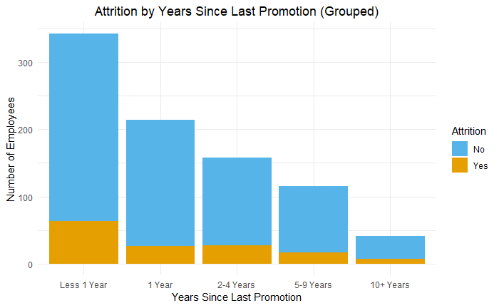
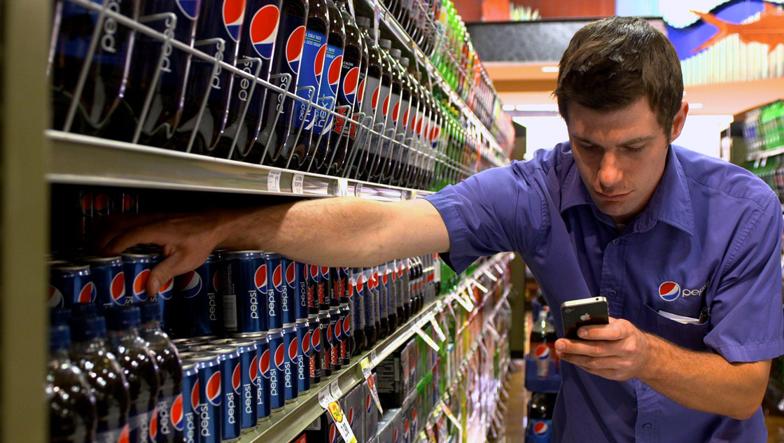
Are the employees leaving just looking for promotions?
Not necessarily, Attrition rates did not differ by promotion time
Attrition | Promotion | < 1 yr | 1 yr | 2 - 4 yrs | 5 - 9 yrs | 10+ yrs
No | 88% | 83% | 83% | 85% | 82%
Yes | 12% | 17% | 17% | 15% | 18%

Slide 5
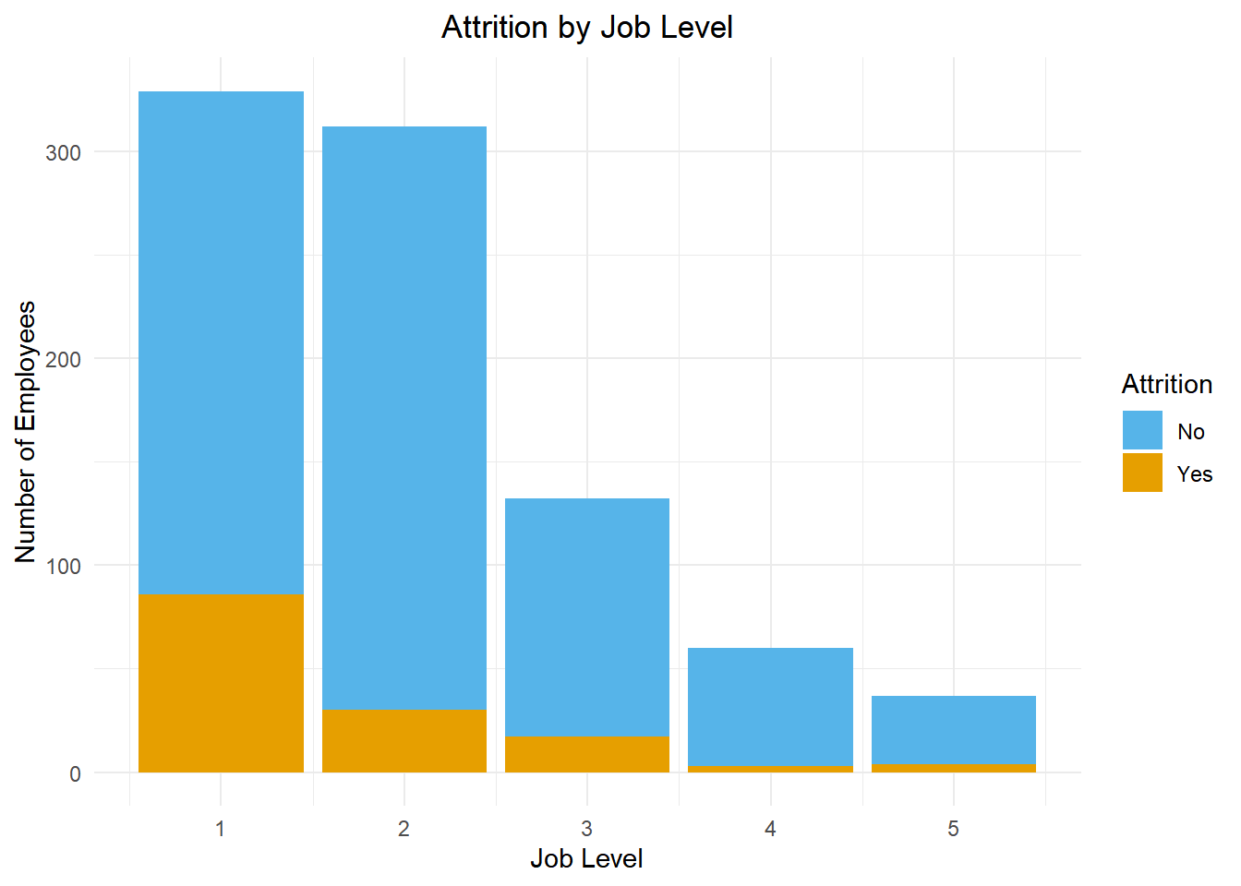
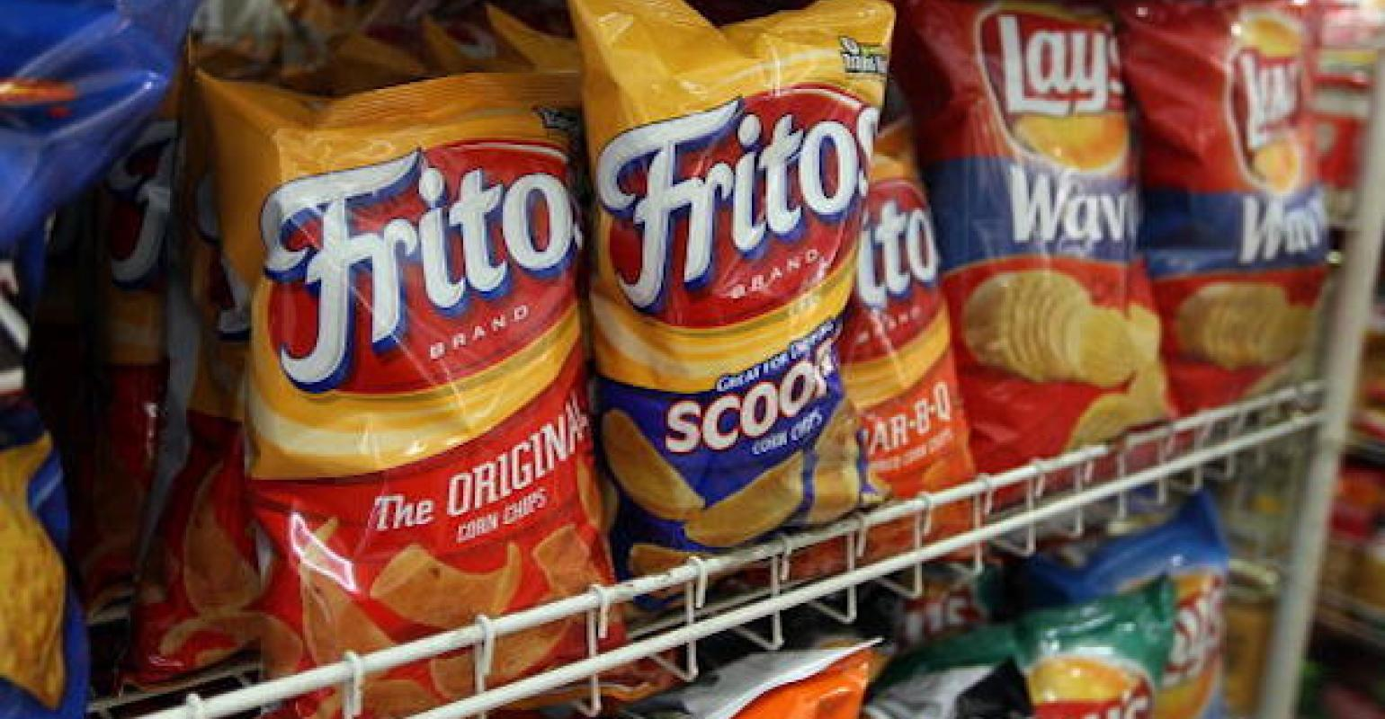
Are lower job levels more likely to churn?
Level 1 jobs had the highest Attrition rate
Attrition | Job Level | 1 | 2 | 3 | 4 | 5
No | 74% | 90% | 87% | 95% | 89%
Yes | 26% | 10% | 13% | 5% | 11%

Slide 6
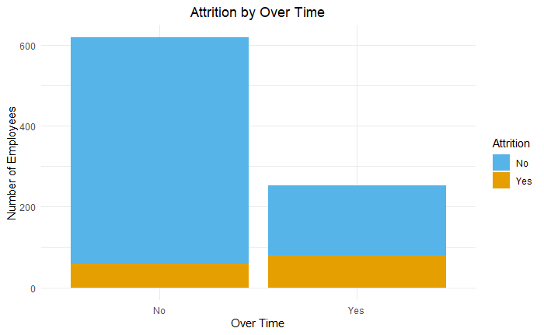
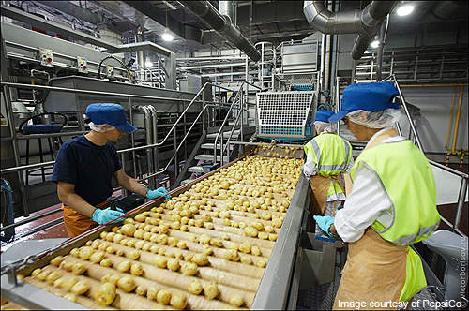
Are over time employees more likely to leave?
Over time plays a significant role in attrition
Attrition | Over time | No | Yes
No | 90% | 68%
Yes | 10% | 32%

Slide 7
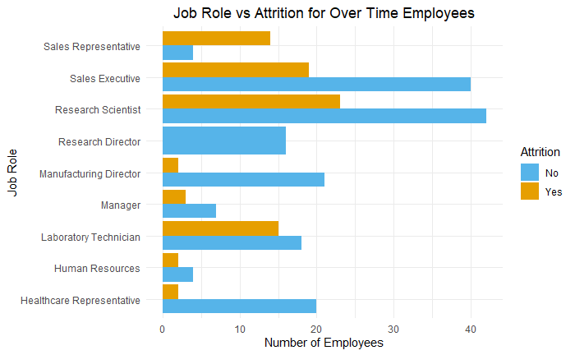
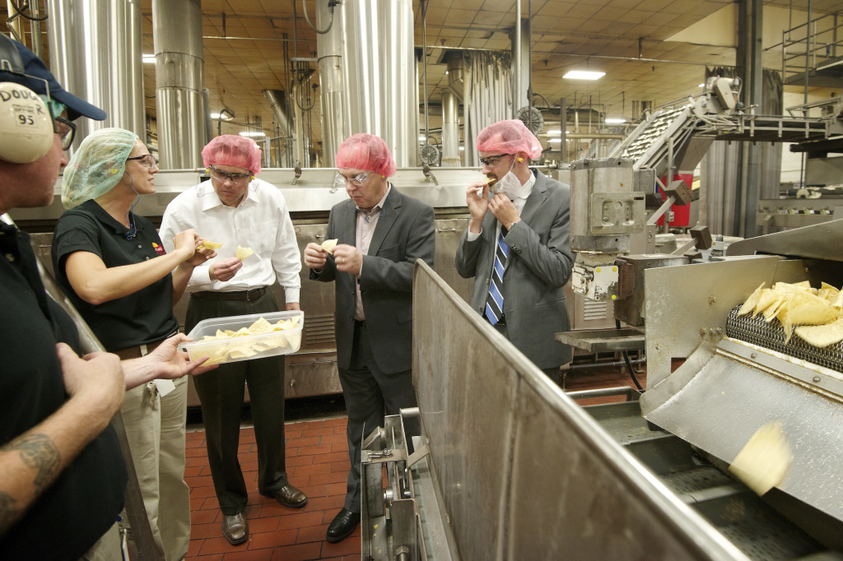
Are there specific over time roles with higher churn?
Highest Over Time Roles with Attrition:
Research Scientist
Sales Executive
Lab Technician
Sales Reps

Slide 8
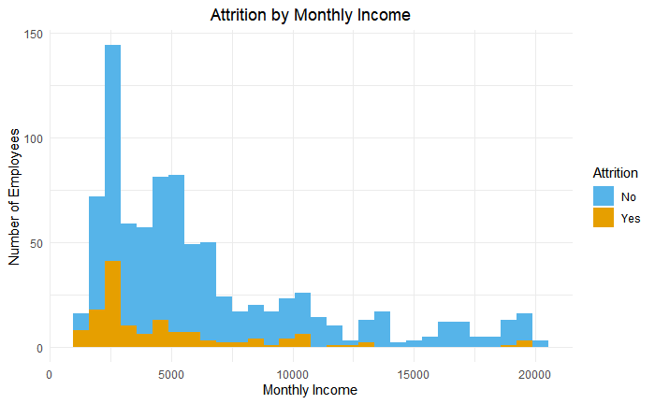
Does salary contribute to employee turnover?

Slide 9
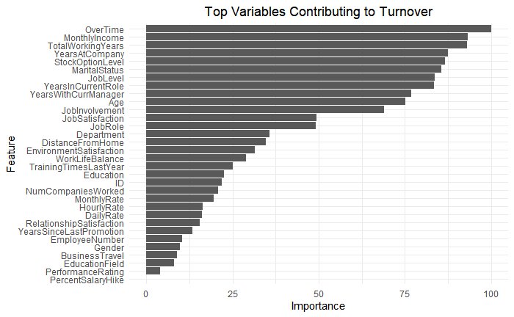
What Contributes to Turnover?

Slide 10


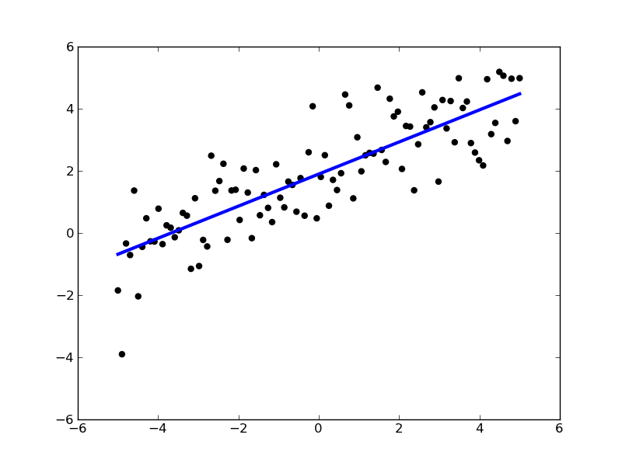
Comparing Models
Support Vector Machine 88% Accuracy 88/100% Sensitivity/Specificity
Generalized Linear Model 90% Accuracy 96/63% Sensitivity/Specificity
Random Forest 89% Accuracy
89/92% Sensitivity/Specificity
Sensitivity: Accurate guesses of “Yes”
Specificity: Accurate guesses of “No”
Notes:
Why chose SVM?: https://towardsdatascience.com/support-vector-machine-introduction-to-machine-learning-algorithms-934a444fca47
Random forest image: https://miro.medium.com/max/1184/1*i0o8mjFfCn-uD79-F1Cqkw.png

Slide 11
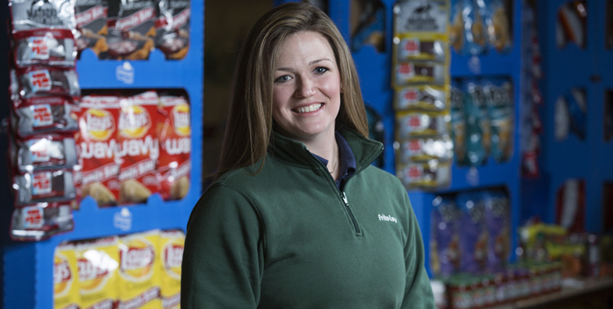
Conclusion
Employees who work over time, have a lower job level & low total years of experience may be a sub-segment of employees to help coach and revisit their working environment
Utilizing a Support Vector Machine Model is Frito Lay’s best predictor of employee attrition

Slide 12
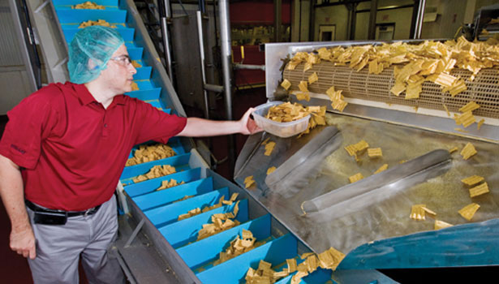
Next Steps
Rerun model with a comprehensive department dataset
Revisit model predictions after 3 additional months of data
Review exit interviews for employees and highlight any common trends (ie. over time, expected promotion to next job level, etc.)

Slide 13
Questions?

Slide 14
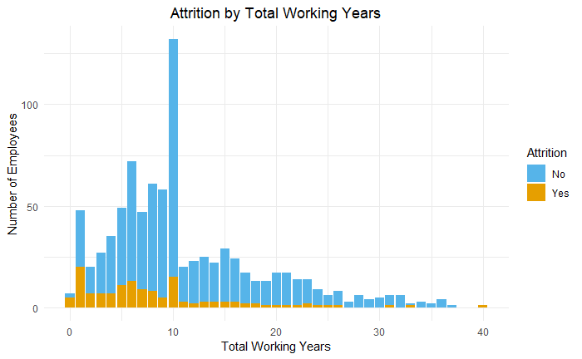
“Greener” employees have higher attrition rates

